Slide 1

SOFTWARE ENGINEERING: PROCESS AND TOOLS
PRT582
Movie Ticket Booking System

Slide 2

Group Name: Radeon
Group Members:
Manan Patel : S361298
Milan Sukhadiya : S355516
Sahil Hada : S359974
Harashdeep Singh : S360797
Ridham Nadoda : S353334

Slide 3

Introduction
This document details the comprehensive testing process for "Movie Ticket Booking System," a web application built using PHP and other front-end technologies.
The project is centered on the concept of giving viewers with an online platform for purchasing tickets, picking their own and customizable seating class arrangements, and other options.
The following project takes use of the SQL Database for fast-paced data access and storage, making it very quick to book tickets, log in, log out, alter their modifications, and also contributed to providing full implementation.

Slide 4
Features
Admin | User
Adding the new theatre | Register new users
Admin login | User login
Add upcoming movie news | Movie ticket booking
Add movies in theatre | Online Payment
Add screen in theatre | OTP validation during payment
Add shows and their timing for screen
Start and stop show

Slide 5

Limitations
Considering the website's limitation is interface limitation, where the mobile experience is limited from a design standpoint.
Furthermore, as compared to other similar concept websites, significant e-commerce capabilities is missing.
Third party payment integration is missing. Hence, some of the payment integration technical issues can be created.

Slide 6
User Stories
Theatre Module: As an admin, I want to configure my dashboard and activities.
User login Module: As a user, I want to login/signup and logout any time.
Movie Selection: As a user, I want to select movies and show times.
Watching Trailers: As a user, I want to watch trailer of the movies.
Making payments: As a user, I want to make a payment with credit/debit card.

Slide 7
Non – Functional Testing
Usability testing
Performance testing
Security testing

Slide 8
Usability Testing
Usability testing is an important feature that displays the user's ease of access while exploring different areas of the website and playing with its capabilities.
Usability testing tools considered:
Maze
Lookback
TryMyUI
Usability hub

Slide 9

Usability Hub is one of the usability testing tools on this page that aims to be straightforward and easy to use.
Advantages:
Ease of use
Various types of testing available.
Kiosk mode
No limit of number of participants.

Slide 10
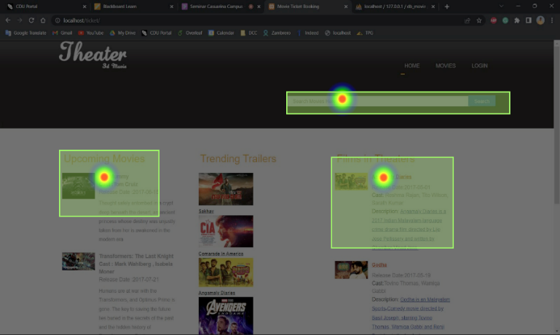
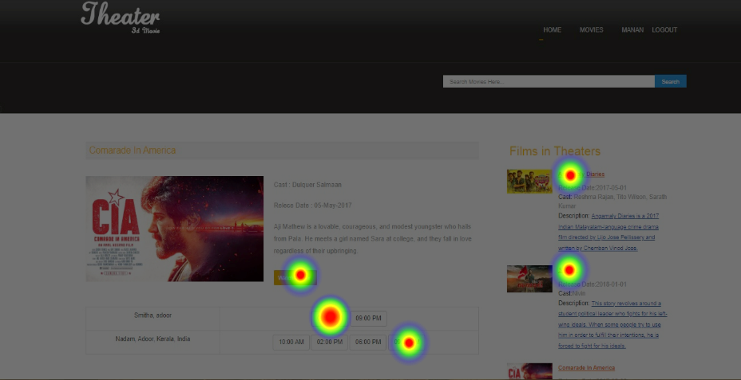
Heat-map Images

Slide 11
Analysis of Result and Suggestions
The heat map pictures are created when a user clicks on a certain sector, and the heat map is used for detail analysis to make the usability interface more suited for the users.
Multiple consumers utilized this website, and we developed a heat map of first click testing based on the aforementioned result images.
First, we must competently describe the demand to the consumers. Furthermore, the goals have been clearly outlined for the users

Slide 12
Persona and Scenario Testing
Profile Background Malik is a customer of Australia. | Goals and Tasks He just wants to book a ticket online instead of booking ticket at cinema.
Anxieties and Motivations He gets motivation and feel better by watching movie. | Frustrations and Concerns He is frustrated from sold out ticket’s situation.
Needs and Expectations Needs an application for booking tickets online and he want to do payment by online banking. | Scenario Malik wants to save time for buying ticket and select movie by watching trailer.

Slide 13
Performance Testing
The application's performance testing is determined by how effectively it is written and the different good programming practices that go with it.
Performance testing tools considered:
LoadNinja
Xhprof
Kobiton
JMeter

Slide 14

JMeter was first created to test the Apache server, but it has subsequently been modified to test a wide range of applications.
Advantages:
Good GUI interface
Extensive reporting options
Ability to simulate high demand

Slide 15
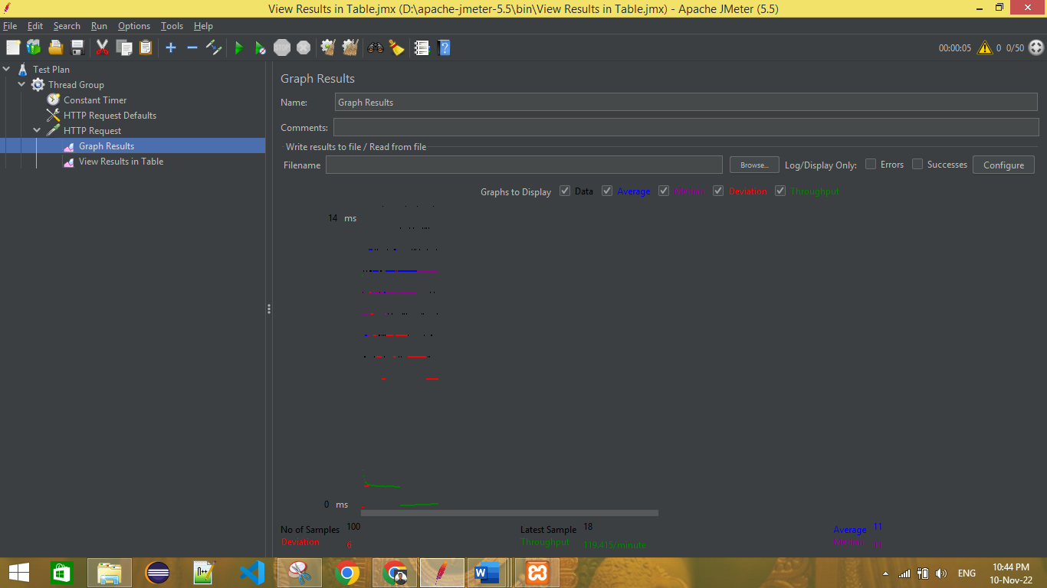
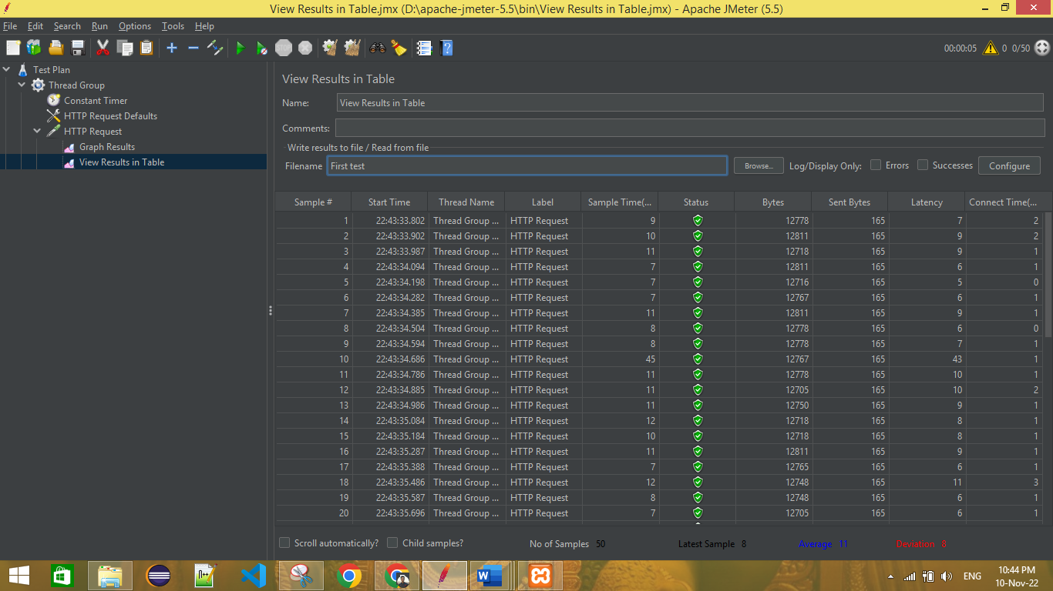
Result Images

Slide 16
Analysis of Result and Suggestions
The images represents two sorts of test results.
The number of threads is 50, with a variance of 6 and an average time sample of 11 minutes.
Prepare the server route for the HTTP request to submit the test case to the web server as a sampler. Furthermore, we must specify the number of threads that will be used in order to assess the results and make suitable modifications.

Slide 17
Security Testing
The application's security is a critical general feature that must be applied and implemented to ensure that the problem is handled.
Security testing tools considered:
Google Nogotofail
SonarQube
Invicti

Slide 18

Enterprise firms may secure thousands of websites using the automated application security testing tool Invicti, which significantly lowers the risk of attack.
The program was created using an upgraded version of PHP, which addressed all security concerns as vulnerabilities were addressed in the code.
It is vital to use SSL certificates to protect the application from hackers.

Slide 19
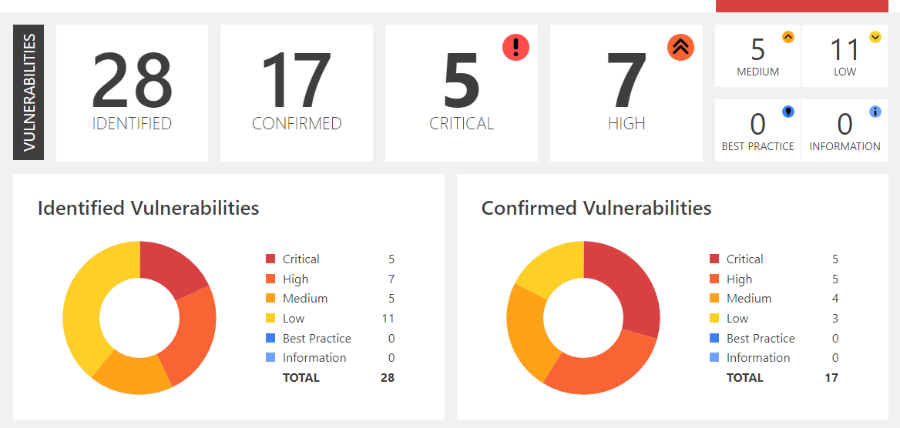
Result Image

Slide 20

Sonarqube is used to perform automatic reviews of the code and perform static analysis to find bugs and code smells.
SonarQube enables us to do various tests quickly and simply.
It also created regexes to prevent stack overflows and other sorts of integration and feedback during the process.

Slide 21
Analysis of Result and Suggestions
Both Invicti and SonarQube security testing tools provide detailed reports on flaws, code smells, vulnerabilities, and code duplications.
According to our findings, we have 1.1% code duplication in the registration and login page code in PHP.
The initial proposal is to improve the database code's proficiency and dependability. Also, duplications of code should be reduced and measured during all frequent updates

Slide 22
Functional Testing
Testing functionality automatically enables the developer to run automated tests to test functions of the actual application.
Functional testing tools considered:
TestProject
MicroFocusUFT
IBM Rational Functional Tester
Robot framework

Slide 23
Robot Framework Testcases
Admin Tests | Description
Add_new_theatre | Add new theatre with valid details
Valid_theatre_login | Verify login functionality with valid username and password
Invalid_theatre_login | Verify login functionality with valid username and invalid password
Add_upcoming_movie_news | Add upcoming movie news with valid details
Add_movie_in_theatre | Add movie in theatre with valid details

Slide 24
Robot Framework Testcases
Admin Tests | Description
Add_screens_in_theatre | Add screen in theatre with valid details
Add_show_in_theatre | Add show in theatre with valid details
Add_showtime_for_screen_in_theatre | Add showtime for screen in theatre with valid details

Slide 25
Robot Framework Testcases
User Tests | Description
Register_new_user | Register new user by clicking the button
Valid_user_login | Verify login functionality with valid username and password
Invalid_user_login | Verify login functionality with valid username and invalid password
Movie_ticket_booking | Book a ticket using card and select movie name, theatre and showtime.

Slide 26
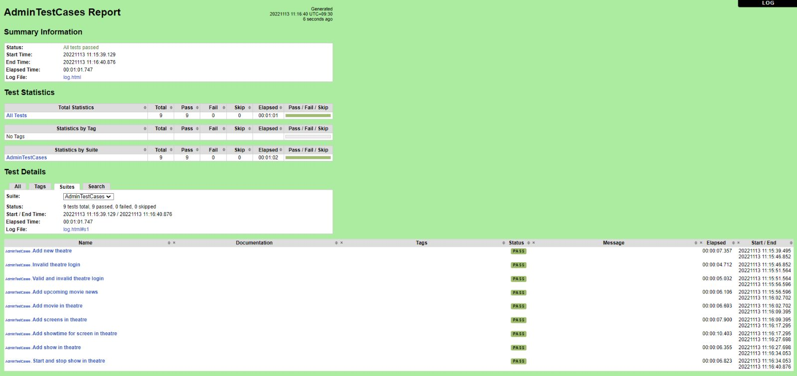
Admin Tests Result

Slide 27
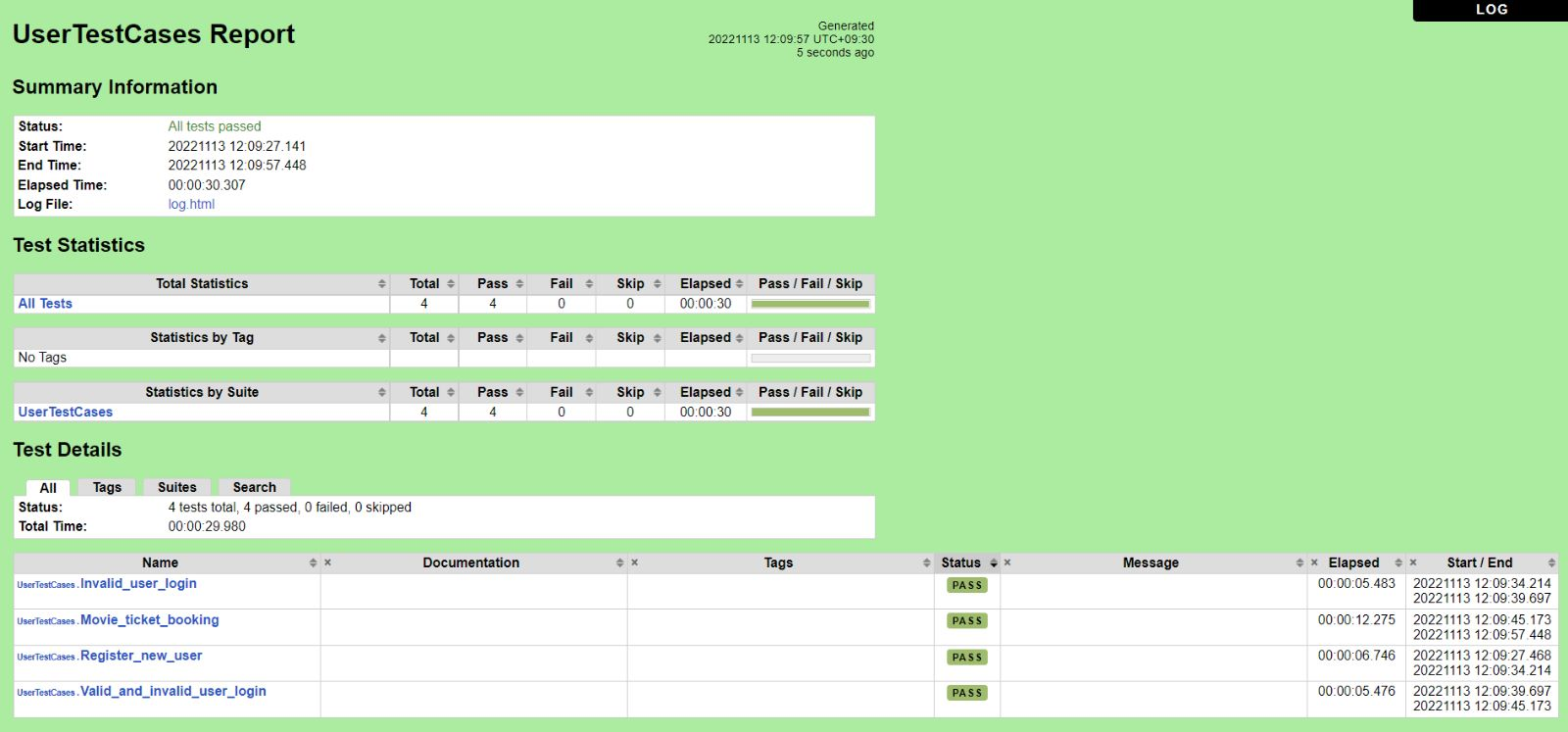
User Tests Result

Slide 28
Thank you

